Slide 1
Triggering Messages
April 20, 2014
Notes:
Guidewire training materials contain Guidewire proprietary information that is subject to confidentiality and non-disclosure agreements. You agree to use the information in this manual solely for the purpose of training to implement Guidewire software solutions. You also agree not to disclose the information in this manual to third parties or copy this manual without prior written consent from Guidewire. Guidewire training may be given only by Guidewire employees or certified Guidewire partners under the appropriate agreement with Guidewire.

Slide 2
Describe how event messages are triggered
Create destinations
Create messages in Event Fired rules

Slide 3
Entities used to trigger messaging
Destinations
Event Fired rules

Slide 4
Messaging entities
EventAware Entity
Entity whose instances can initiate messaging
Specified <event /> element
Message Context
Internal, non-persistent, virtual entity
Run-time only
Message
Contains details about the message
Stores details in the XX_MESSAGE database table
Entity Event
Event Fired Rules
Destination
xx_message
EventAware entity
message context
message
Notes:
Most entities are persistent entities. Persistent entities describe specific information and store data in the database. An event-aware entity is specifies an <events /> element in its definition which means that the entity delegates to the EventAware delegate. A delegate is an entity associated with an implemented interface that multiple parent entities can reuse. The EventAware entity is an internal, non-persistent entity that implements the messaging interface. For all entities that implement the EventAware delegate, the Guidewire application automatically creates specific events: entityNameChanged, entityNameRemoved, and entityNameAdded.
MessageContext is an internal, non-persistent entity. Internal, non-persistent entities are virtual entities that are created a run-time and do not store data in the database.
Message is a persistent entity that stores information about the message process in the Message database table. Users do not create message entities.

Slide 5
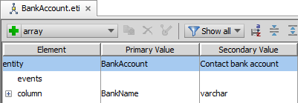
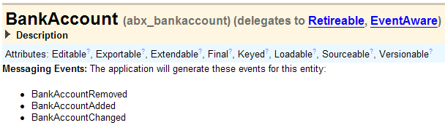
EventAware entity
An EventAware entity is an entity whose instances can initiate messaging and store data that is of interest to external systems
<event />
EventAware entities delegate to the EventAware data model delegate
Notes:
You can identify that an entity is EventAware by reviewing the entity in the Entity Editor in Guidewire Studio. You can also review the Data Dictionary to see the entity implements the EventAware delegate.

Slide 6
Messaging Events
A messaging event often occurs when adding, changing, or removing an instance of an EventAware entity
<entity><typeOfChange>
Naming convention
<typeOfChange> is default is Added, Changed, or Removed
BankAccountChanged
Notes:
A messaging event typically occurs when an instance of an EventAware entity is created, changed, or deleted. Almost every EventAware entity has Added, Changed, and Removed events. The full list of events for each application is listed in the application's Integration Guide. You can also find this information in the Data Dictionary. In the Data Dictionary, there is a Messaging Events section that lists the message events for the EventAware entity.
An entity can have additional events, such as:
ClaimCenter:
Claim entity's ClaimResync event
PolicyCenter
Job entity's RequestQuote event
Submission entity's BindSubmission event
PolicyPeriod entity, which has a number of events to accommodate policy transactions, such as IssueSubmission, IssueRenewal, and SendCancellationNotices.
BillingCenter
DelinquencyProcess entity's ConnectToCollectionAgency event
Invoice entity's InvoiceResent event
OutgoingPayment entity's OutgoingPaymentStatusChanged event
Payment entity's PaymentStatusChanged event
Data import tools such as ImportToolsAPI and import_tools command line tool are generic mechanisms for loading system data or sample data into the system and do not trigger messaging events doe EventAware entities. Bulk data loaded using the table import tools also do not trigger messaging events. When loading business data that requires messaging events, do not use these tools, APIs, and mechanisms.

Slide 7
MessageContext entity
EventAware entity
MessageContext
Message
MessageContext is an internal, non-persistent, virtual entity only used in Event Fired rules to create messages
Identifies the event
It can be used to reference data from the triggering entity
Notes:
Event Fired rules depend on the message context object. You can access this object using the messageContext variable. The messageContext object contains information such as the event name, messaging destination ID, and the Root object. Event Fired rules often generate one or more messages, although the logic can omit creating messages as appropriate.

Slide 8
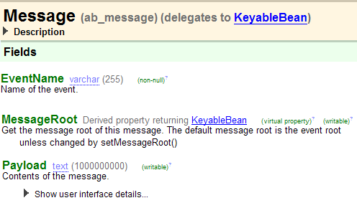
Message entity
Message entity a payload containing the data to be sent to an external system
EventName describes the name that triggered the message
MessageRoot is a pointer to the triggering entity instance
Payload is a text field with the information to communicate
Notes:
Avoid unnecessarily large or complex messages if possible. A message is information to send to an external system in response to an event.

Slide 9
Triggering message events in code
ABContactRecommended
entity.addEvent("customEventName")
Only for EventAware entity <events />
Triggered manually in code
When the object is committed, the event is triggered
Example:
anABContact.addEvent("ABContactRecommended")
Useful when messaging must be initiated by something that cannot be captured in a standard message event
Notes:
Custom events provide additional flexibility in the messaging architecture. Sometimes, you may want to trigger a message event in a context where an EventAware object hasn't necessarily been created or changed. For example, you may want to provide the user with the ability to trigger messaging by clicking a button on the user interface. In some cases, you want to group messaging logic at a more granular level than EntityChanged.
There may be significantly different messaging requirements for a Request entity that is approved as opposed to one that is denied. In other cases, you may want to send another message event during the processing of a message acknowledgement. Message events cannot be triggered for non-EventAware entities.

Slide 10
Entities used to trigger messaging
Destinations
Event Fired rules

Slide 11

Destination
Guidewire Application
Destination
External System
A message destination is an abstraction of an external system that receives and replies to messages
Examples:
PC: Billing system that receives charges for new policies
BC: Policy administration system that receives request to cancel policy when payment is not received
CC: Police report system that receives requests for police reports concerning auto accidents
Notes:
Each Guidewire message is sent to a single destination only. If there is a situation where multiple external systems need to receive the same information in response to a single event, then the Event Fired rules should create multiple messages, one for each destination of interest. (The term "multicasting" means that the same message is sent simultaneously to multiple receivers. Guidewire message does not make use of multicasting.)
Every message should receive a response. The response indicates to Guidewire that the message has been successfully processed. In some cases, the response comes immediately upon sending the message and simply indicates the message was successfully consumed. In other cases, the response comes sometime after the message is sent. The response can also contain data from the external system (such as a verification code or a report).
The mechanism for the external system response depends on if the message is synchronous or asynchronous. For synchronous replies, often the message transport plugin is the reply mechanism. For asynchronous replies, often a Guidewire Application published web service or a message reply plugin is the reply mechanism.

Slide 12
Destination message events
BankAccount Changed
BankAccountAdded BankAccountChanged
Destination 13
BankAccountChanged
Destination 14
Bank
Account 2637
ActivityAdded ActivityChanged
Destination 15
Messaging destination listens to one or more specific message events
When a message event occurs:
One MessageContext is created for each destination that listens to that event
Each MessageContext is then processed by business rules
Notes:
In the example above, BankAccount 2637 is an instance of BankAccount, an event-aware entity. There are also three destinations. Destinations 13 and 14 listen for the BankAccountChanged event. Destination 15 does not. When BankAccount 2637 changes, a MessageContext object is created for destination 13 and destination 14. But because destination 15 does not listen for BankAccountChanged events, no MessageContext is created for BankAccount 2637.

Slide 13
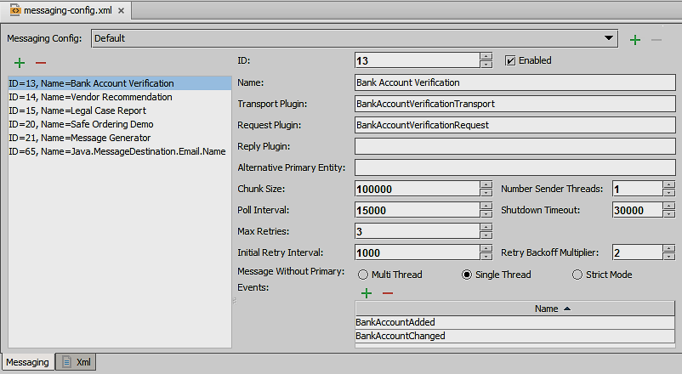
Defining a messaging destination
Required fields
Unique ID value from 0 to 63
Unique Name
Messaging events that the destination listens for
Transport plugin is required
Sends message to external system(s)
Optional plugins
Request plugin transforms the payload
Reply plugin manages asynchronous acknowledgements
Additional parameters
See Acknowledging Messages lesson
Destination
Notes:
The message ID must be an integer from 0 to 63, inclusive. Values greater than 63 are reserved by Guidewire. The message destination can specify up to three messaging plugins: message transport plugin, message request plugin, and message reply plugin.
The message transport plugin is responsible for sending your message to the external system. The nature of this plugin will vary depending on the external system and/or the technology used to communicate to the external system (such as a JMS queue, a web service request to an external system, or an FTP call). Every destination must provide a message transport plugin implementation, but multiple destinations can use the same implementation.
The message request plugin transforms a message's payload immediately before sending it. For example, two messages might be sent from a single event, but data received in a reply to the first message (such as an external identification code) might need to be included in the second. Because this identifier is not known at the time the message payloads are initially created, the request plugin is needed to transform the payload of the second message. If a given destination requires no payload transformation, then this plugin is not implemented.
The message reply plugin initializes a listener queue and associates it with the destination. This plugin is used for destinations that receive asynchronous replies via a listener queue. If a given destination does not reply asynchronously (or it does reply asynchronously, but the replies are received through some other mechanism, such as a web service), then this plugin is not implemented.

Slide 14
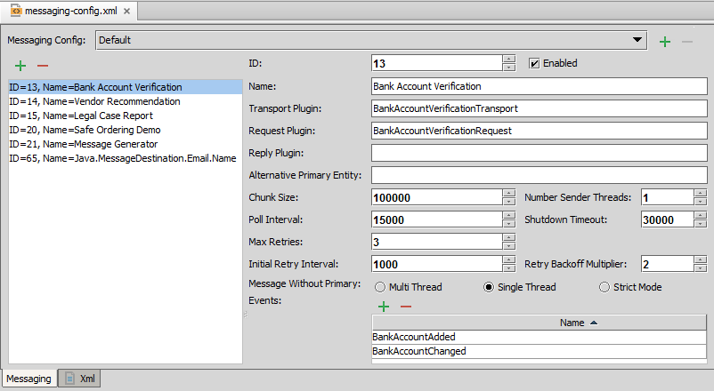
Messaging editor
Unique ID
Unique Name
Required Transport Plugin
Optional Plugins
Connectivity and Error Parameters
Messaging Events
Specify required field values
Specify the messaging events
Use <entity><typeOfChange>
Notes:
For messaging plugins, you can implement any number of MessageRequest, MessageTransport, and MessageReply plugins, though each destination can use at most one of each type. Every destination can use only one message reply plugin. However, a given message reply plugin class can be used by multiple destinations.
The strings in the Events list are regex patterns. For example, if the Events list included the string "BankAccount", then the destination would listen for "BankAccountAdded", "BankAccountChanged", and "BankAccountRemoved". In practice, though, it is best to explicitly list all the events a destination listens to.
Developers must be careful to spell the regex patterns in the Events list correctly, as the destination will not work as expected if they are spelled incorrectly. For example, a destination that listens for "BankAccountChanged" will not respond to a BankAccountChanged message event.
You can have multiple sender threads for a single destination, which allows multithreaded access to the plugins and potentially better performance when sending messages. Multiple sender threads are meant primarily to accommodate destinations that use synchronous web service calls and other synchronous remote calls, which are stateless. If you choose to assign multiple sender threads, be careful that your plugins are actually thread safe (for example, sharing a JMS Session across threads would NOT be thread safe) and that the resulting higher load on the reply plugin (if used) is acceptable. Do NOT set the sender threads value above 1 for destinations using transport or request plugins that are not thread safe. Such thread safety is often dependent on the external system itself being able to handle multithreaded communications properly.
The Enabled checkbox controls whether the Event Fired rules are run for a destination.

Slide 15
Entities used to trigger messaging
Destinations
Event Fired rules

Slide 16
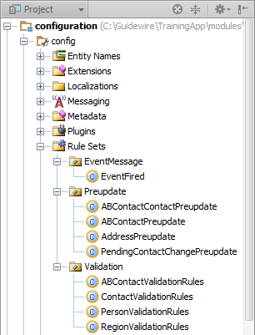
Guidewire business rules
Three types of Rule Set Categories
EventMessage
Preupdate
Validation
Rule condition code resolves to true or false
When condition is true, Rule action code executes
A business rule written in Gosu accomplishes some task for a given entity, and executes when a specific event occurs to instances of that entity
Notes:
Business rules are covered in the Business Rules lesson in Configuration Fundamentals. Your instructor may discuss this and the next slide in detail or skip over them depending on whether that lesson was covered in your delivery of the Configuration Fundamentals course.
Setting a rule condition to true means that the action will always be performed whenever the rule is evaluated.
Notice that there is no condition test. It is implied. The only valid condition is a Boolean expression.

Slide 17
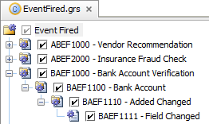
Rule set execution
Rules executed after triggering event
Rule execution follows order listed in Studio
Per node, Rules are executed in a hierarchy of rules
If parent rule condition is true, then child rules executed
Notes:
If a rule has child rules and the parent rule condition is false, neither the parent action nor the child rules are executed.
All top-level rules in a rule set are executed unless an explicit "exit" is encountered.

Slide 18
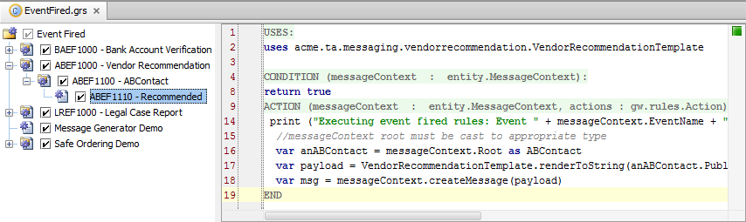
Rule set editor
View and edit Rule Set and Rules
Rule Editor
Rule Hierarchy
Rule Hierarchy
Context menu
Activate/Deactivate checkbox
Drag-and-drop ordering
Rule Editor
Overlays segment Uses, Condition, and Action
IMPORTANT
Do NOT delete keyword return in condition
Notes:
You can think of a rule set as a logical grouping of rules that are specific to a business function. You typically organize these rules sets into a hierarchy that fits your business model. Guidewire strongly recommends that you implement a rule-naming scheme that is hierarchal in nature. A hierarchal naming convention will reflect the hierarchal structure when you create rules and organize rules into a hierarchy. However, the naming scheme for rules corresponds to the file structure on disk. So, if it has too many levels customers can run into problems with file names being too long on Windows.
A rule set combines many individual rules into a useful set to consider as a group. A rule set is a collection of rules that share the same root entity and share common triggers. In the example above, the rule set is Event Fired.grs. Selecting the rule set in the editor displays the rule set description and details the root entity. In this example, the root entity is entity.MessageContext.
In a rule set, a Guidewire application evaluates the individual rules recursively in the hierarchy, unless an exit action is encountered. The process starts with the first direct child of the root and then evaluates all children and siblings. All rules in a rule set are processed unless an explicit "exit" is encountered.
Individual rule files have the file extension .gr. For each rule, there is a condition and action. The Rule Editor provides overlays to segment the condition and action. When a rule condition evaluates to true, the Guidewire application executes the rule action.
An inactive rule is not executed. You can activate and deactivate rules to get the rules engine to selective process and ignore rules. To deactivate a rule, disable the check box that appears to the left of the rule name. Inactive rules appear in gray. To reactivate the rule, enable the check box. To delete or rename a rule, right-click the rule and select the appropriate command from the context menu.

Slide 19

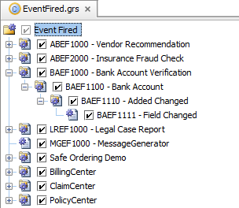
Event Fired rule set
Responsible for
Creating messages
Generating message payloads
NOT responsible for:
Sending messages
Transport plugins sends
Acknowledging messages
Transport or reply plugins acknowledge message
Event Fired Rules
Destination
xx_message
message context
message
Notes:
The top-level Event Fired rule conditions are checked for every entity-event/destination combination. For example, if seven destinations listen to a given event, and you have 20 Event Fired rules, then every time the event is fired, 140 checks need to be made. Thus, it is critical to keep your Event Fired rules organized to avoid duplicate checks.

Slide 20
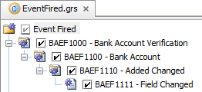
Event Fired rule set hierarchy structure
messageContext.DestID == 13 messageContext.Root typeis BankAccount
messageContext.EventName == "BankAccountAdded" or…
(messageContext.Root as BankAccount).isFieldChanged ("BankName")
Create a rule hierarchy to filter MessageContexts
First, by destination ID...
Then, by root entity type...
Then, by event name...
And finally, by any other relevant logic such as field changed
Notes:
Every MessageContext is processed by the entire Event Fired rule set. However, each is typically of interest to a small subset of rules. Therefore, you should create a hierarchy to filter MessageContexts whenever possible.

Slide 21

Creating messages from MessageContexts
messageContext.Root typeis BankAccount
Root field is of type Object
To extract information from it, cast object it to the appropriate type
messageContext.createMessage(PayloadString)
Returns message object
Use for creating payload
messageContext.createMessage(MessageObject)
Returns message object
Notes:
In the example above, the message payload is simply "Payload for account xxx" where "xxx" is the account number. This does not match the payload that was shown in the messaging example earlier in this lesson. The following lesson discusses how to generate payloads. Prior to that discussion, the simpler "Payload for account xxx" payload will be used in the examples.

Slide 22
Modifying data in Event Fired rules
xx_message
triggering entity
message context
Event Fired Rules
Message
Data changes in Event Fired rules do NOT trigger pre-update rules or validation logic
Avoid changing data (except for the message itself)
Do NOT change properties used outside of Event Fired rules
Do NOT add or delete entity instances
Event Fired rules execute within the same database transaction as the initial data change
Exceptions thrown in Event Fired rules roll back the transaction and all of its data changes
Notes:
In the diagram above, the triggering entity, the message context, the Event Fired rules, and the Message all sit on a single blue arrow. This arrow represents the one transaction in which all of these entities belong and in which the Event Fired rules work. Any exception that is thrown before the message gets committed to the xx_message table will roll back all changes back to and including the change in the triggering entity.
The sending of the message occurs in a separate transaction.

Slide 23
Deploy Destination and Event Fired Rules
Restart Server
Reload Changed Classes
Destinations
Read only at server startup
Any changes to destinations require a server restart
Event Fired rules
Assuming Studio is running/debugging the application
Destination
Event Fired rule set
Rule Class (.gr)
Notes:
You must restart the server when you create or modify destinations.
For transport plugins and/or custom web service classes, you must reload changed classes. If your classes reference newly created display keys, you must reload PCFs (ALT+SHIFT+L).
For newly created and modified event fired rules, you must reload changed classes. If you create a rule hierarchy (parent rule and then children rules), you must restart the server.

Slide 24
Describe how event messages are triggered
Create destinations
Create messages in Event Fired rules

Slide 25
When does a message event get triggered?
What is the primary purpose of the MessageContext entity?
A Guidewire application has seven destinations and an event-aware entity called Escalation. When an Escalation is created, what is the maximum number of MessageContexts that might get created? What is the minimum?
What plugin is required for every destination? What does this plugin do?
Why does every Event Fired rule cast the MessageContext.Root object it receives?
Notes:
Answers
1) Typically, a message event gets triggered when an event-aware entity is created, changed, or removed. (There are also other application-specific message events.)
2) The primary purpose of the MessageContext entity is to create messages using information from the message event and the triggering entity.
3) Seven, which would occur if all seven destinations listen to EscalationAdded. Zero, which would occur if none of the destinations listen to EscalationAdded.
4) MessageTransport, which sends the message to the external system.
5) MessageContext.Root is of type Object, but message payloads typically need to work with the MessageContext.Root as the type of entity that triggered the message event. Therefore, the MessageContext.Root entity must be cast to be of that type.

